Slide 1





Centre for Optophysiology
A new core facility located in the Department of Physiology at the University of Toronto and at The Centre for Phenogenomics (TCP)

Slide 2
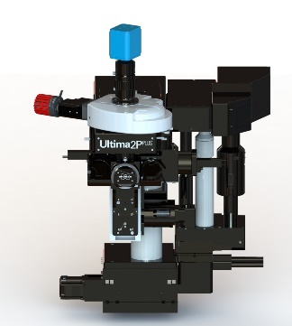
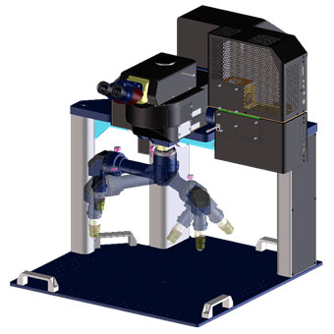
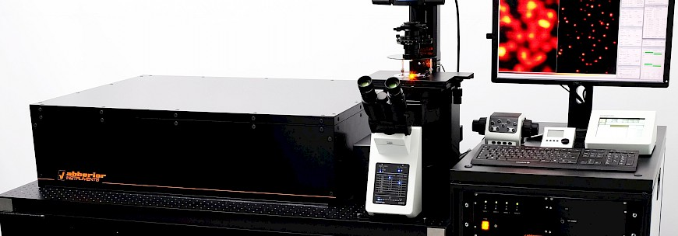
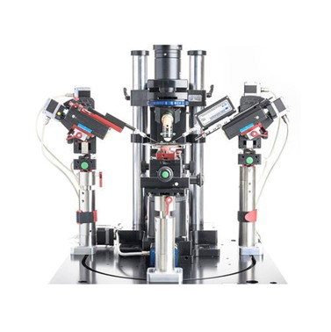
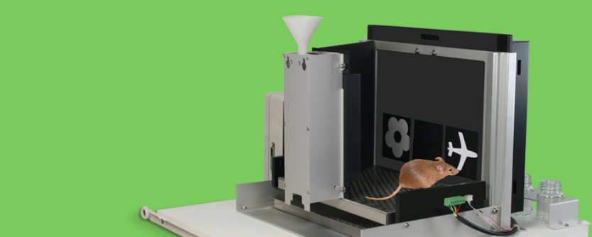
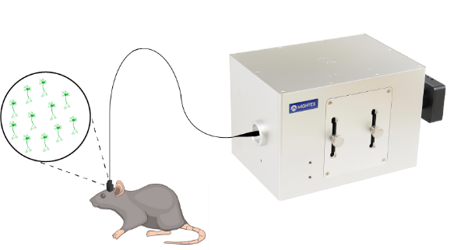
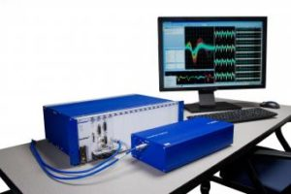
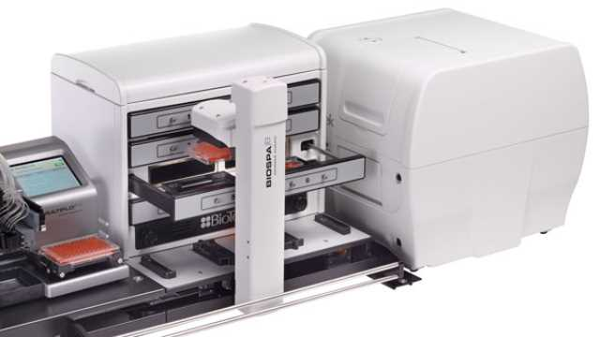
Dual extended wavelength laser multiphoton imaging
In vitro MSB
In vivo TCP
Deep in vivo multiphoton imaging
Super resolution microscopy
Translatable cognitive testing in mice
Simultaneous
in vitro electrophysiology
Automated imaging for development of optogentic probes
Photoactivation and imaging in live behaving mice
In vivo electrophysiology

Slide 3
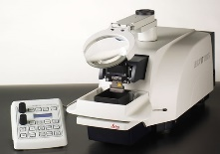
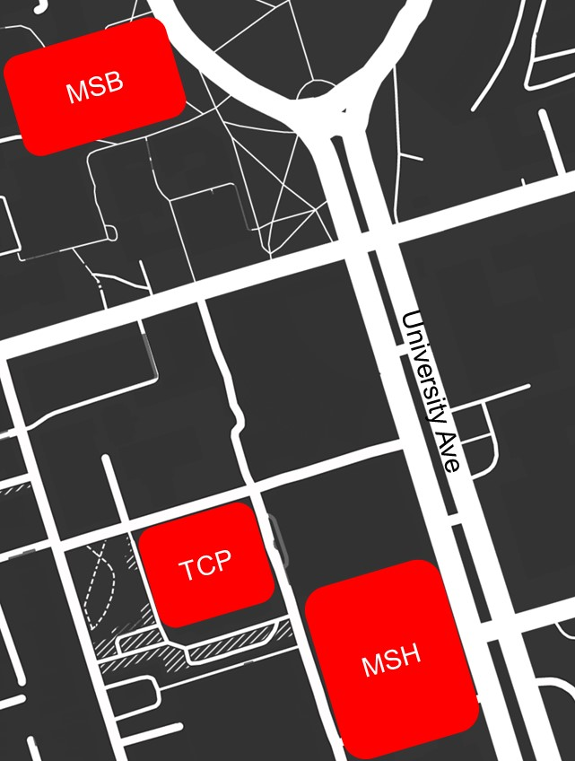
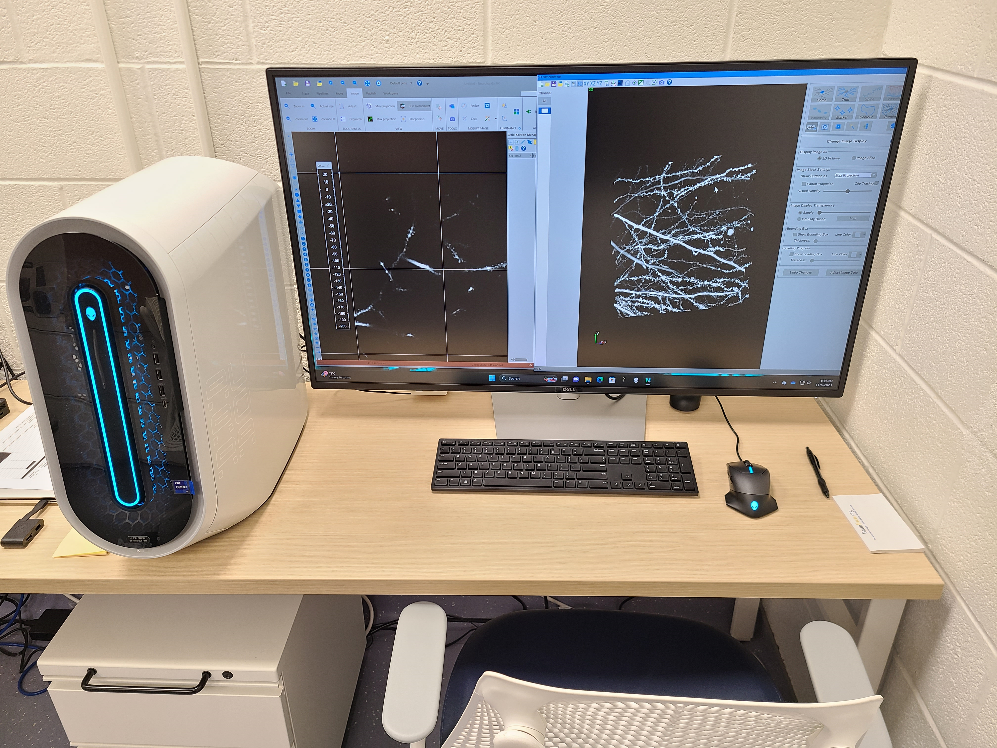
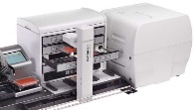
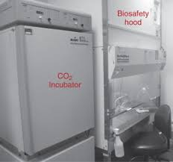
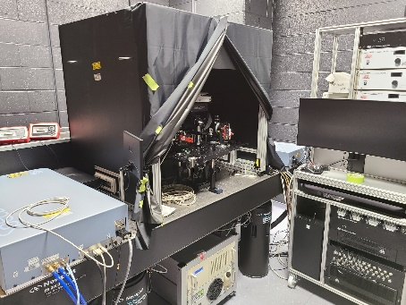
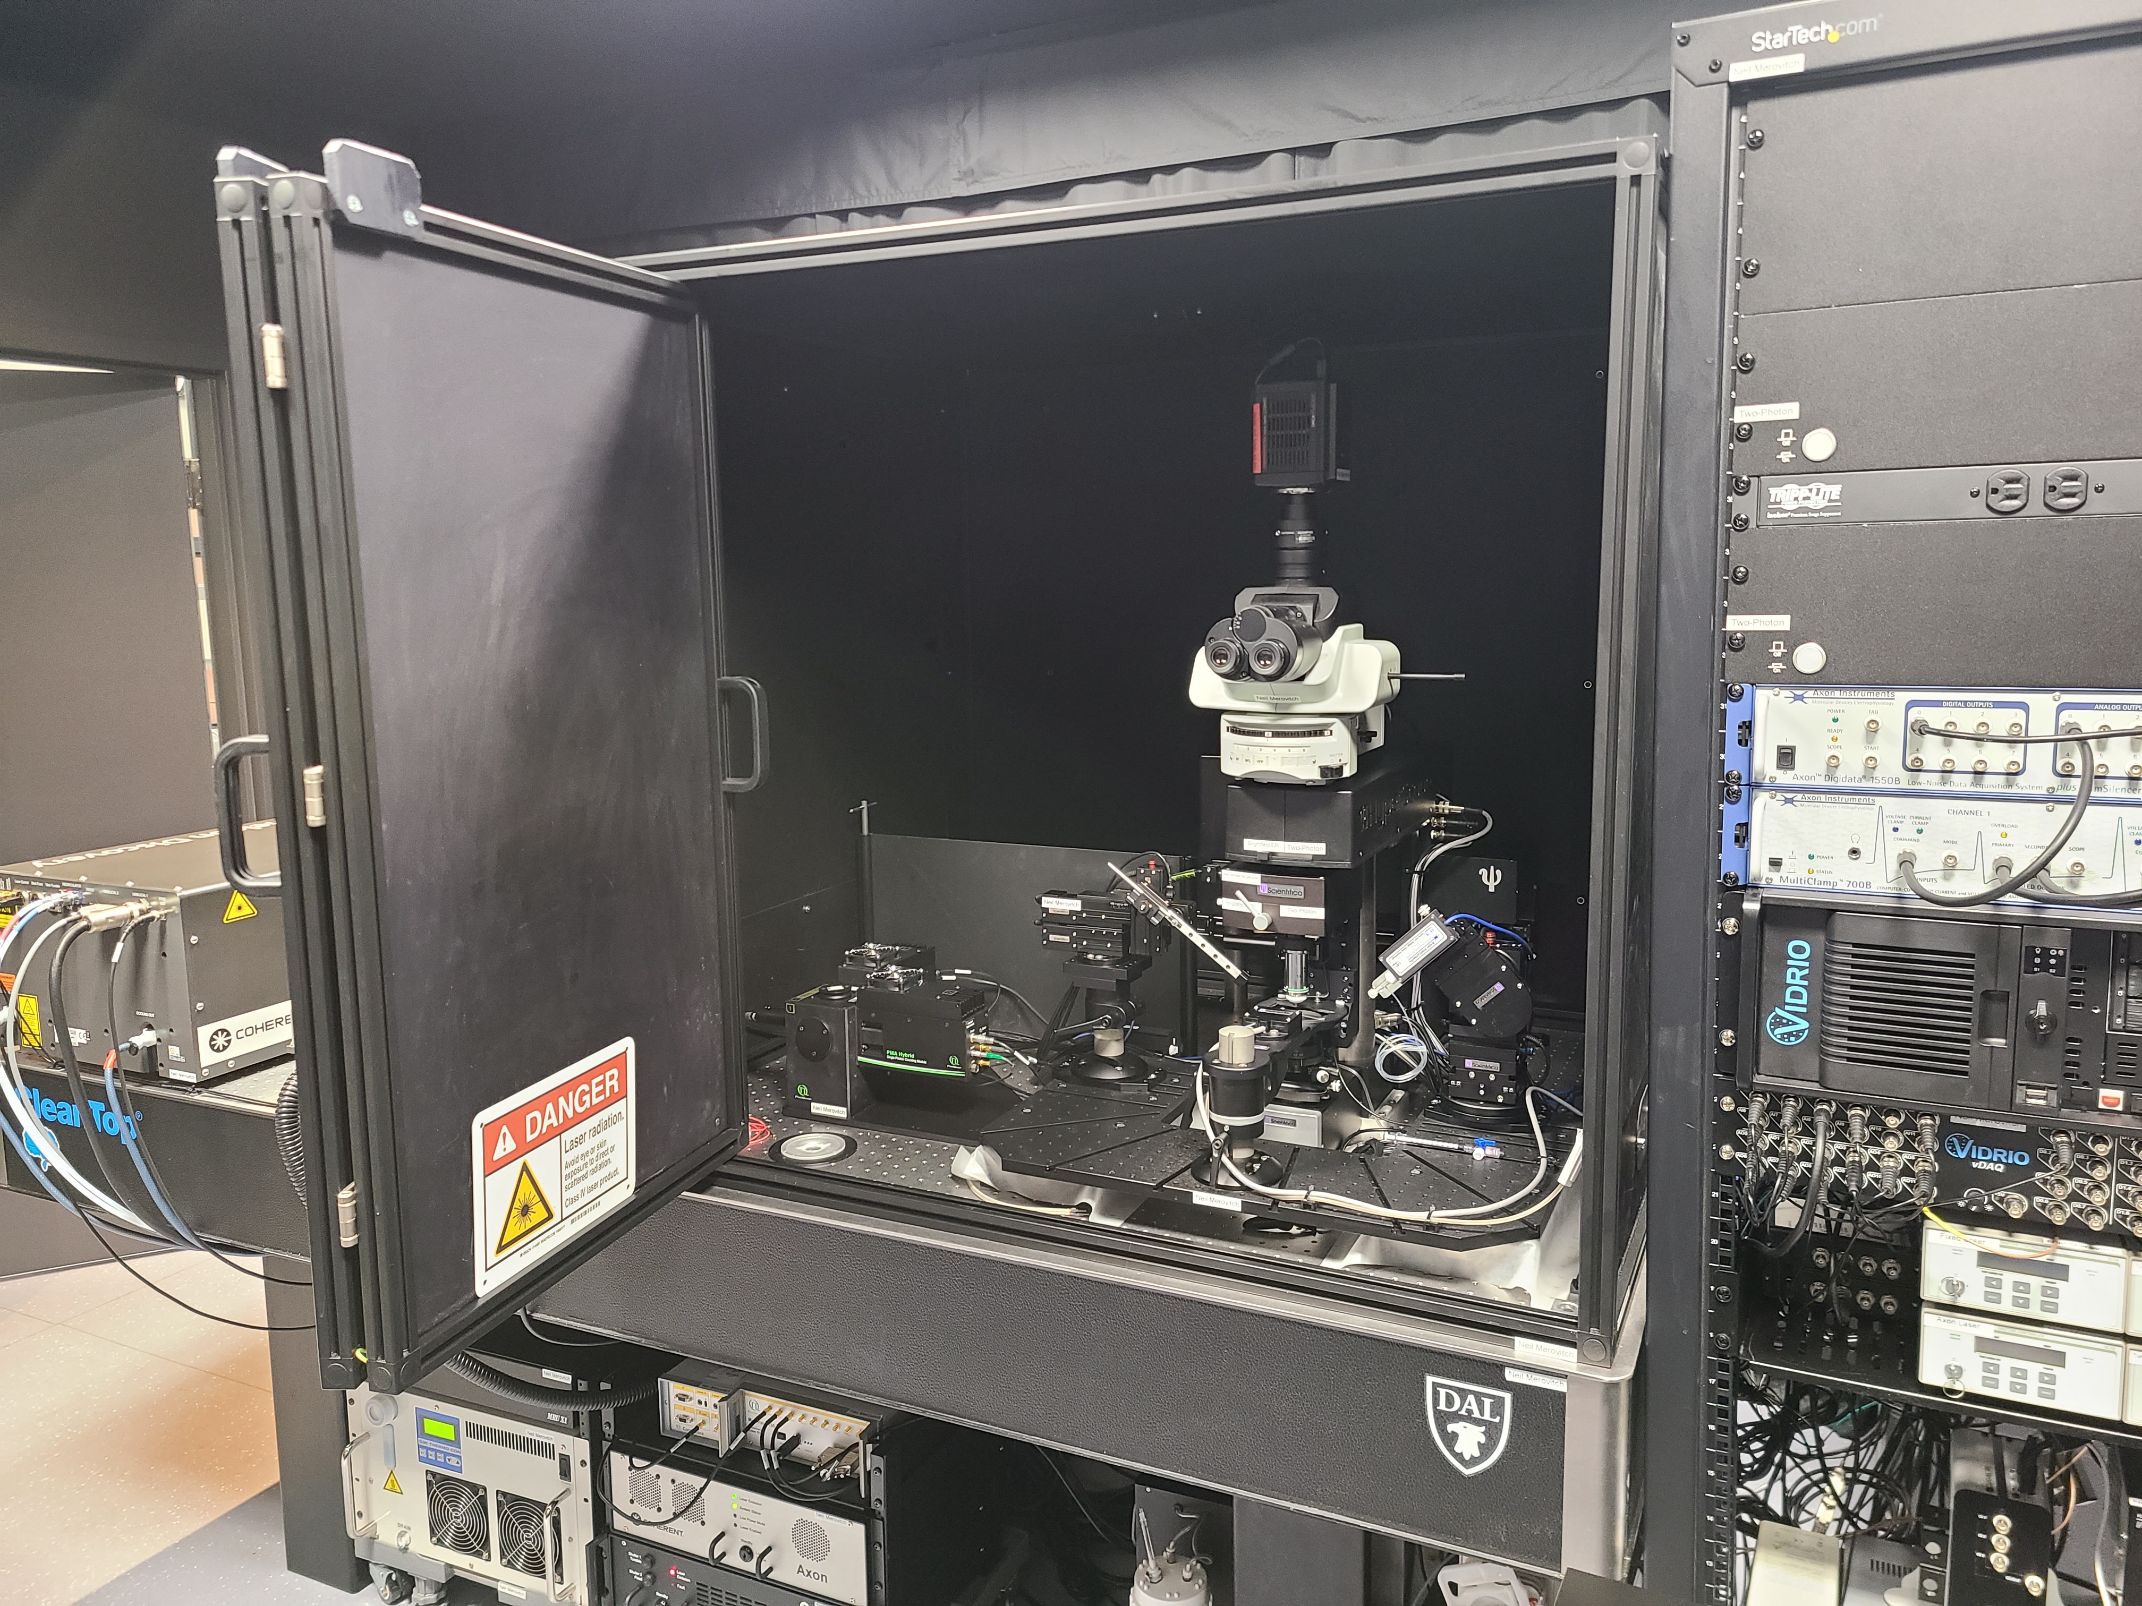
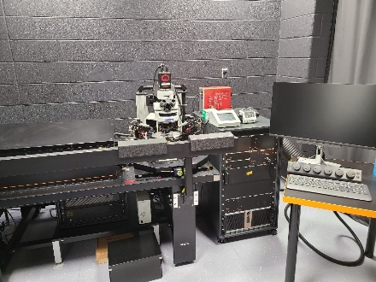
Location 1: In vitro at The Physiology Dept. MSB 3214/3216

Slide 4

2-Photon microscopy: Scopes
Bruker
Scientifica HyperScope
Scott Heximer

Slide 5
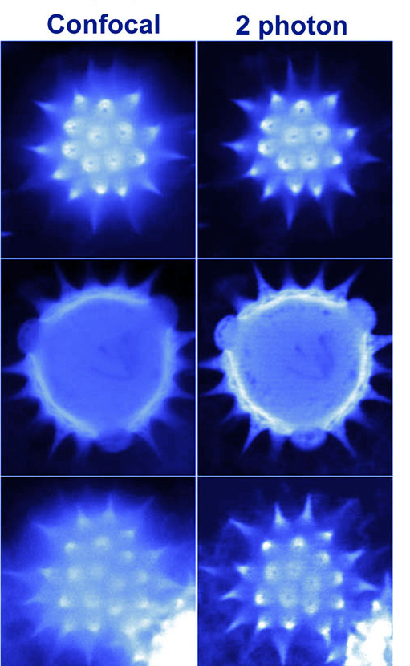
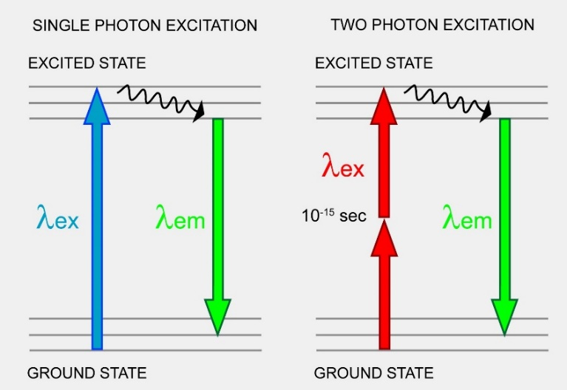
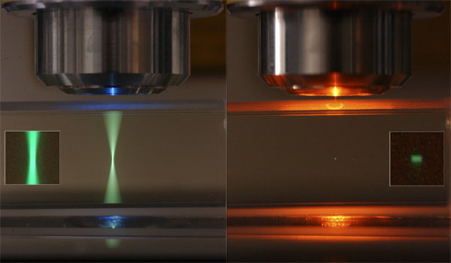
2-Photon microscopy: Advantages
longer wavelength light used is more penetrating (less scattering and absorbtion)
-greater excitation
IR has lower energy and so there is reduced phototoxicity / damage
1 femtoliter
Light sent directly to the photomultiplier tube
-more sensitive
Optical sectioning is achieved because 2 photons are only absorbed at the focal plane where peak power is highest

Slide 6
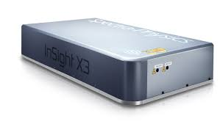
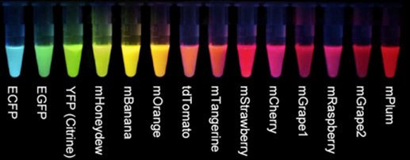
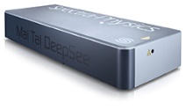
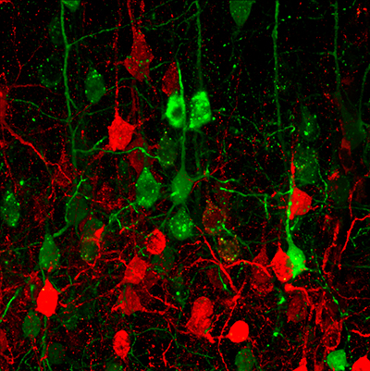
Multiple 2 photon imaging / stimulation combinations possible
Spectraphysics Insight X3 tuneable laser (680 nm to 1300 nm)
Spectraphysics MaiTai eHP DS (690 nm to 1040 nm)
Activation:
+
Palfi et al., 2018
λ 920 – 1300 nm
λ 720 nm

Slide 7
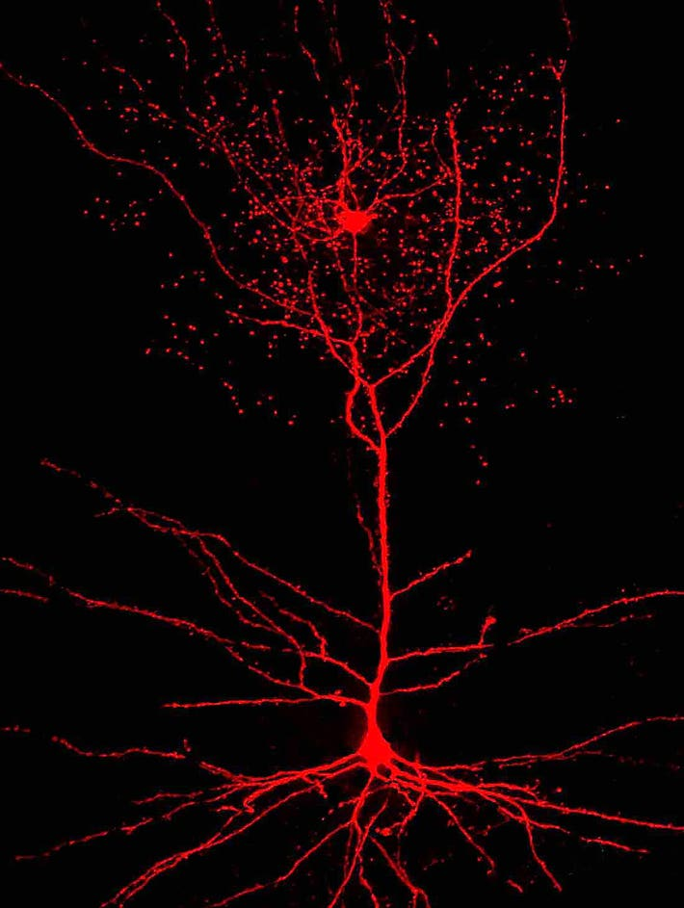
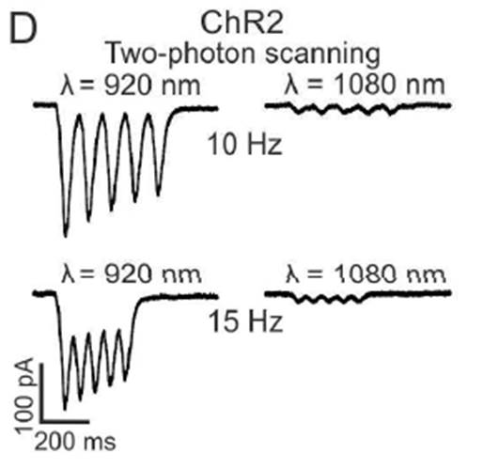
Multiple 2 photon imaging / stimulation combinations possible
Spectraphysics Insight X3 tuneable laser (680 nm to 1300 nm)
Spectrahysics MaiTai eHP DS (690 nm to 1040 nm)
3.5W
Activation:
+
Forli et al., 2018
λ 1080 – 1300 nm
λ 920 nm

Slide 8
Multiple 2 photon imaging / stimulation combinations possible
Spectraphysics Insight X3 fixed output laser (1045 nm)
Spectraphysics Insight X3 tuneable laser (680 nm to 1300 nm)
Spectrahysics MaiTai eHP DS (690 nm to 1040 nm)
3.5W
Activation:
+
Forli et al., 2018
λ 1080 – 1300 nm
λ 920 nm

Slide 9
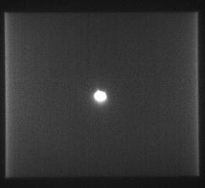
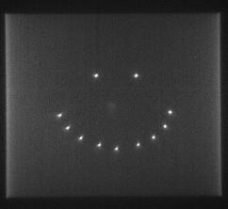
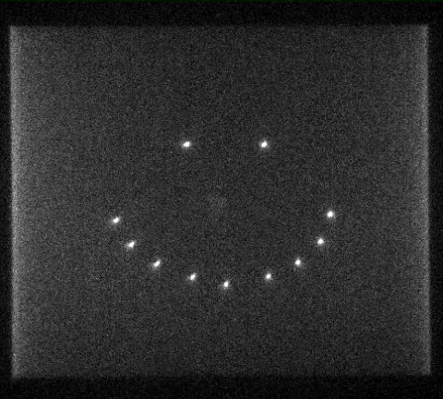
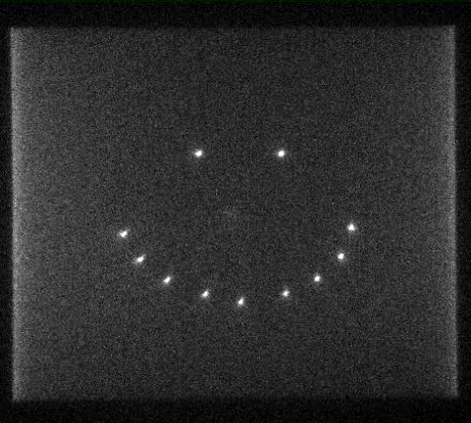
Spatial Light Modulator (SLM) - Bruker
In vitro
Simultaneously activate multiple regions (synapses or cells)
SLM conjugated to secondary galvos: scan and pan 3 dimensional holograms
Closed Loop Experiments with Prairie Link Interface
Yang and Yuste, Current Opinions in Neurobiology 2018
SLM Phase Mask Applied and Galvos Spiral Scanning
Galvo hopping to pan hologram
Photostim Laser ON
SLM Phase Mask Applied
Courtesy of Adam Packer, animations by Lloyd Russell, Michael Häusser’s Lab, UCL

Slide 10
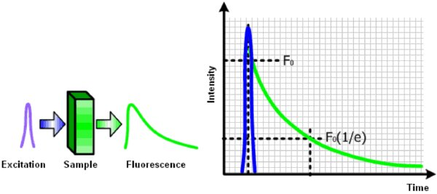
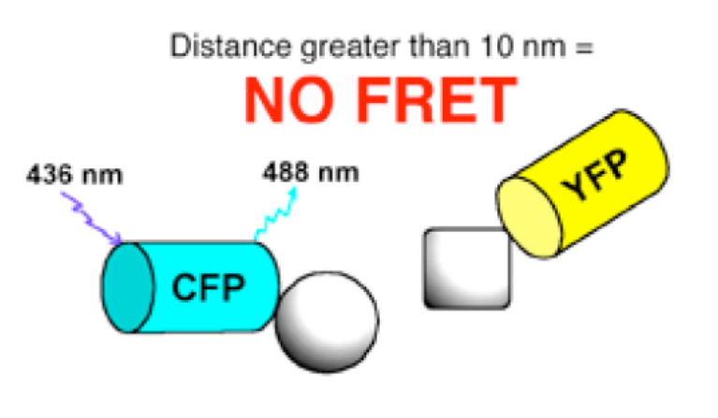
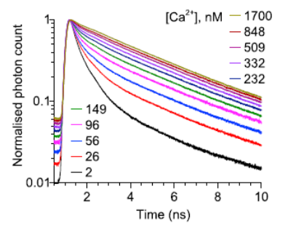
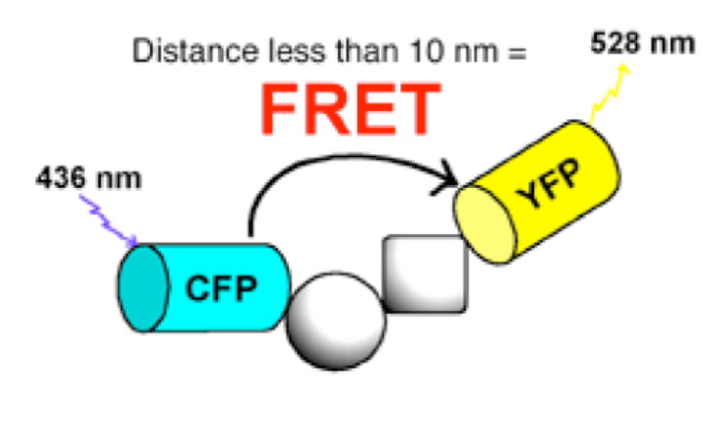
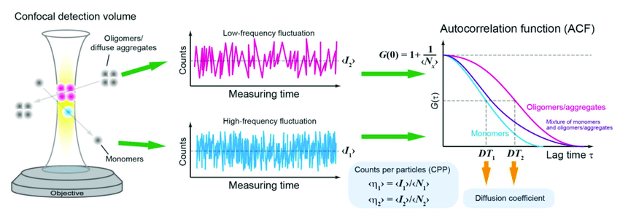
Fluorescence lifetime imaging (FLIM) - Bruker and Scientifica
In vitro
Measure
[Ca²⁺]
Measure
association
(Zheng et al 2015)
The [Ca²⁺] readout is not affected by dye concentration, light scattering, photobleaching, micro-viscosity, temperature (Light absorption and scattering in organized tissue are strongly wavelength dependent, so ratiometric dyes are not ideal)
Fluorescence correlation spectroscopy (FCS) - Bruker
Fluorescence correlation spectroscopy (FCS) is a correlation analysis of fluctuation of the fluorescence intensity.
Measure concentration and diffusion
Also Measure association in FCCS

Slide 11
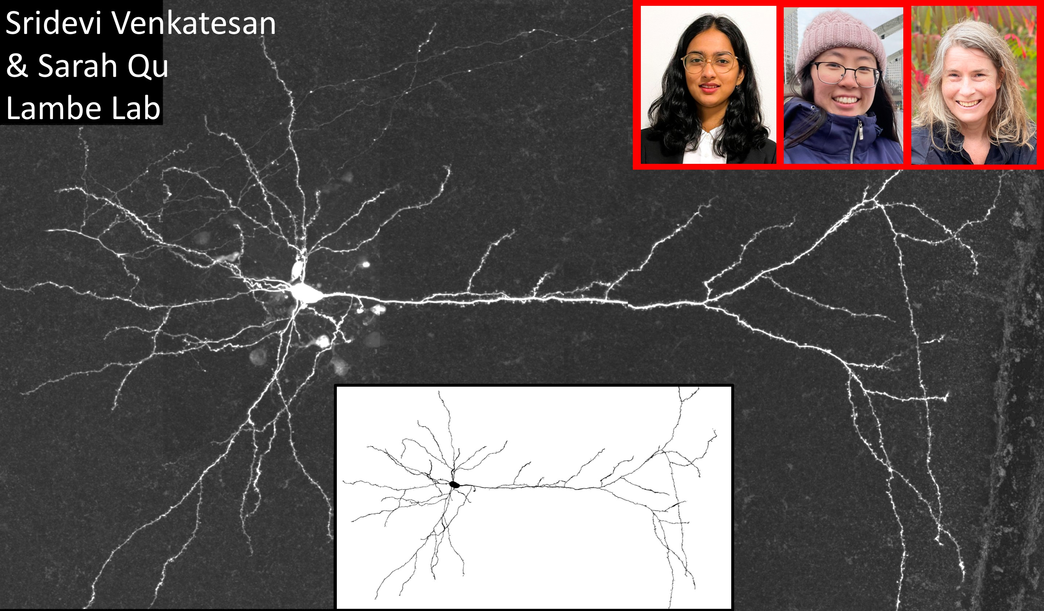
Layer 5 pyramidal neuron in prelimbic cortex, filled with neurobiotin during patching, fixed, and then fluorescently labelled with streptavidin-Alexa594
Neurolucida 360

Slide 12
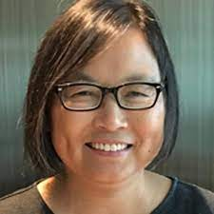
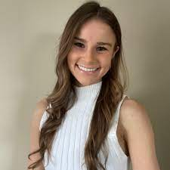
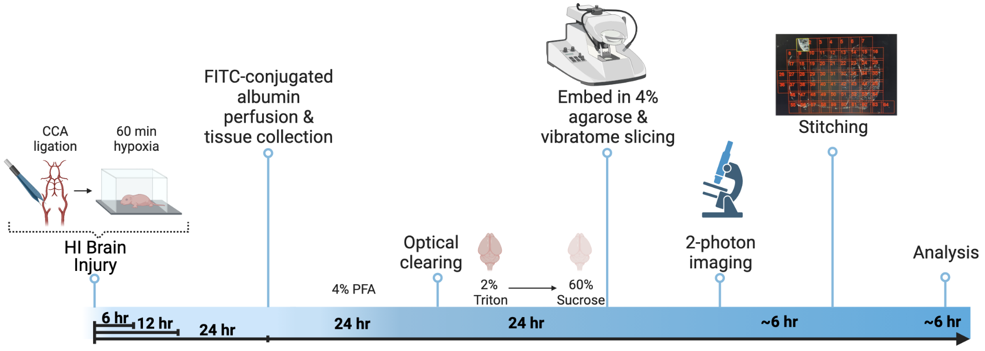
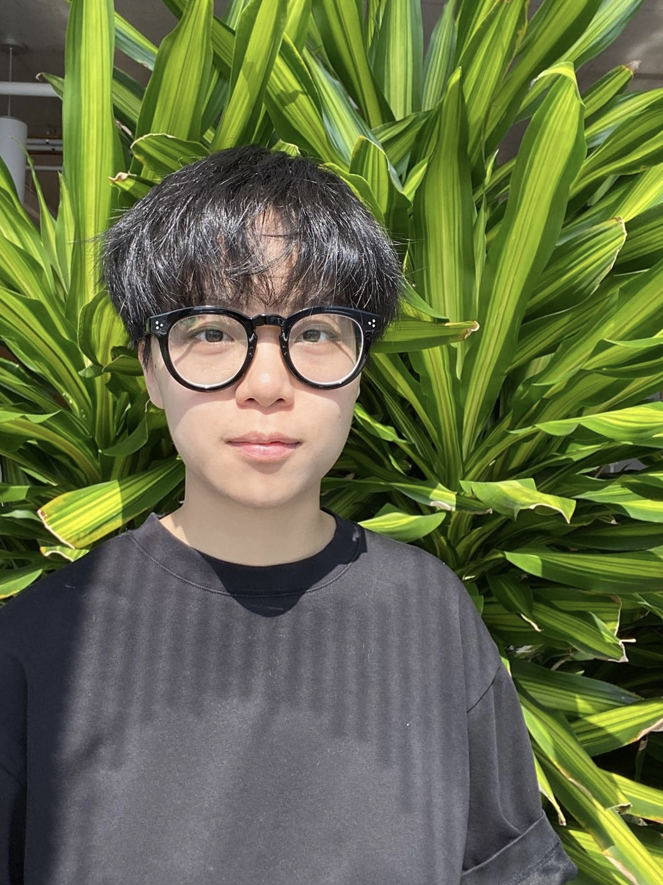
Cerebrovascular architecture in the neonatal mouse brain post hypoxic-ischemic brain injury
Dr. Zhong-Ping Feng
Andie Ovcjak
Atlas Imaging
Zhengwei Luo

Slide 13
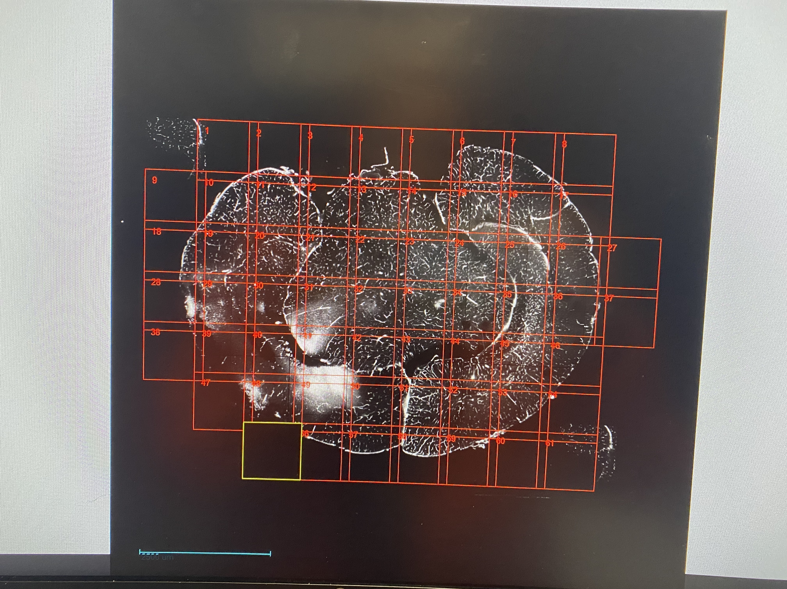
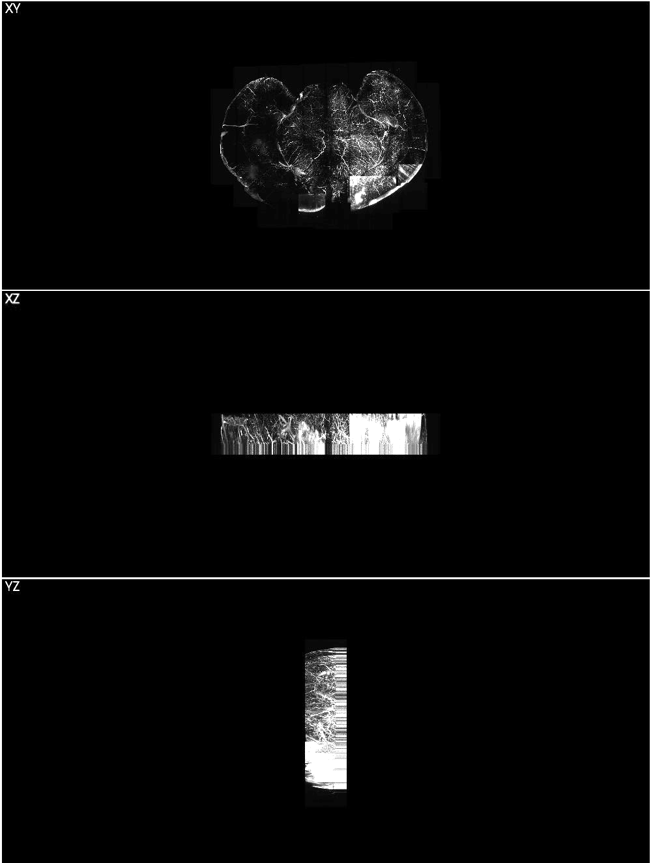
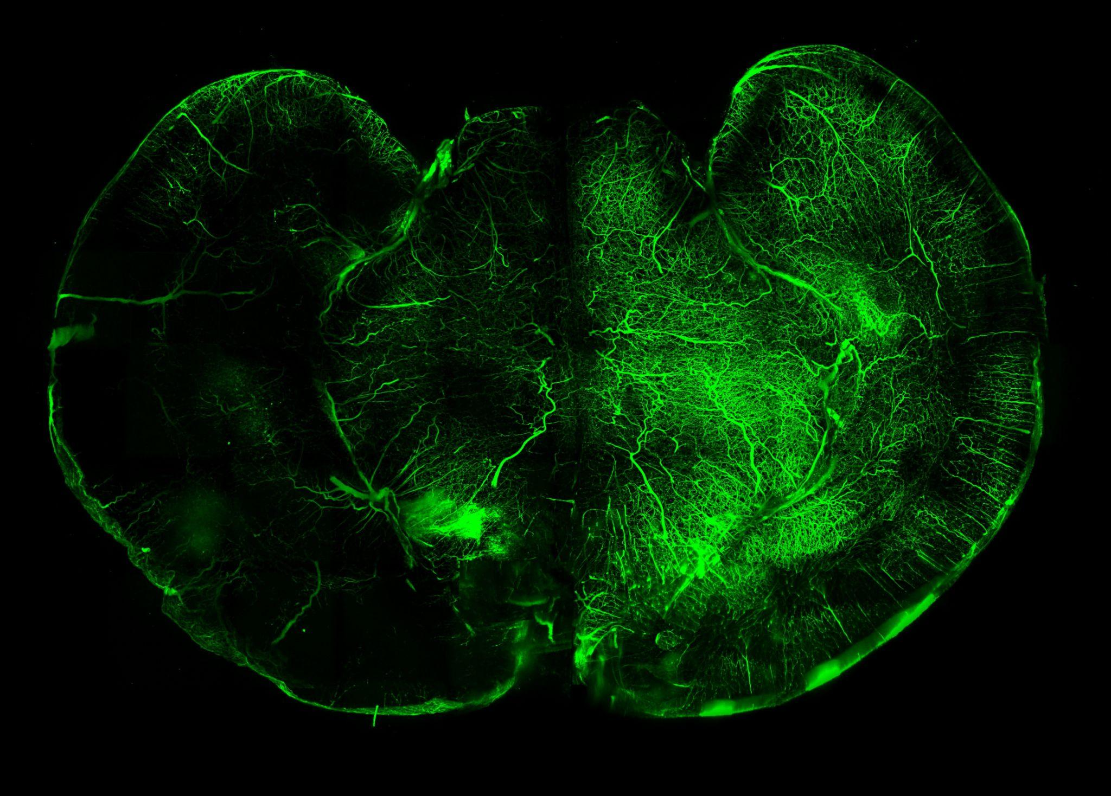
Maximum intensity projection of 2P dataset:
XYZ stitching
XY
XZ
YZ
Z stack: 800 um
Step size: 4 um
Average frames/image: 32
Tiles: 60-70 tiles (201 slices/tile)
FITC-conjugated albumin perfused through the vasculature of the animal allows us to visualize and quantify changes in the microvascular architecture.
Properties of the 3D vascular tree that are calculated: vessel length, vessel diameter, vessel segment density, vessel length density, percent capillaries, percent blood volume.
Cerebral vasculature of postnatal day 8 mouse pup, 24 hr following hypoxic-ischemic brain injury (unilateral CCA ligation + hypoxia)

Slide 14
Stimulated emission depletion nanoscopy (STED)
In vitro

Slide 15
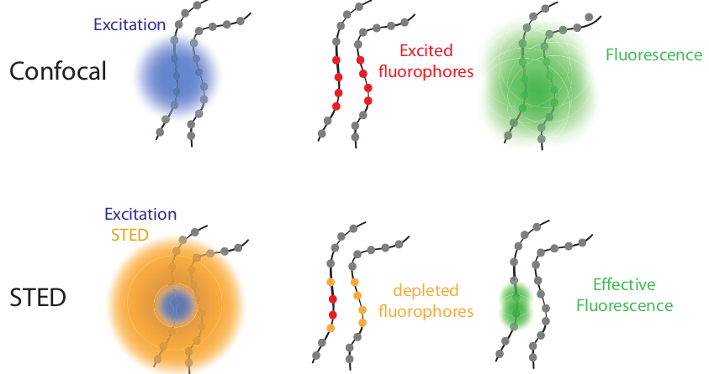
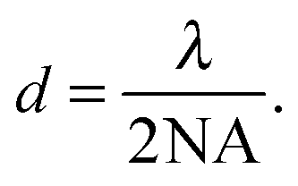

Stimulated emission depletion microscopy (STED)
Resolution

Slide 16
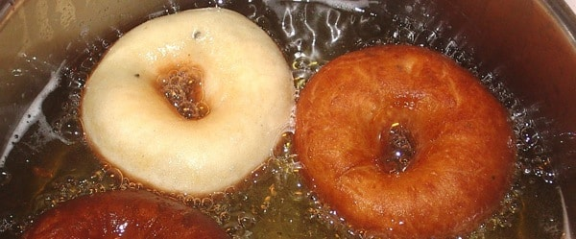
Stimulated emission depletion microscopy (STED)

Slide 17
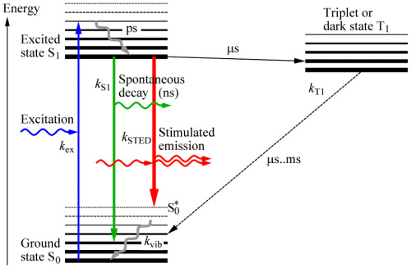
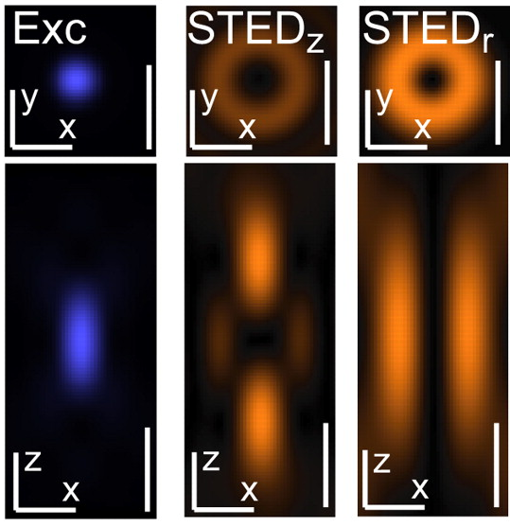
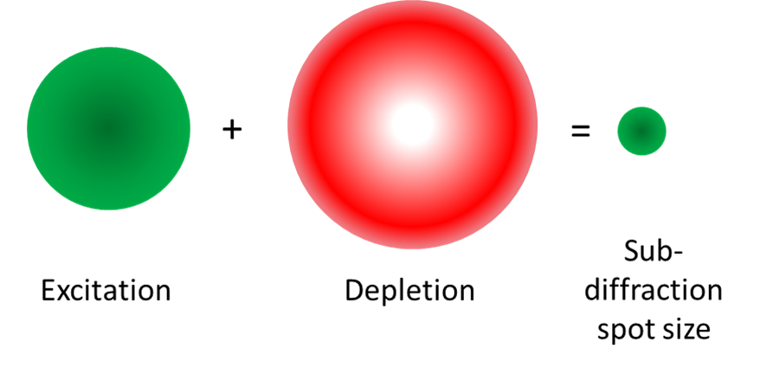
In vitro
Stimulated emission depletion microscopy (STED)

Slide 18
Stimulated emission depletion microscopy (STED)

Slide 19
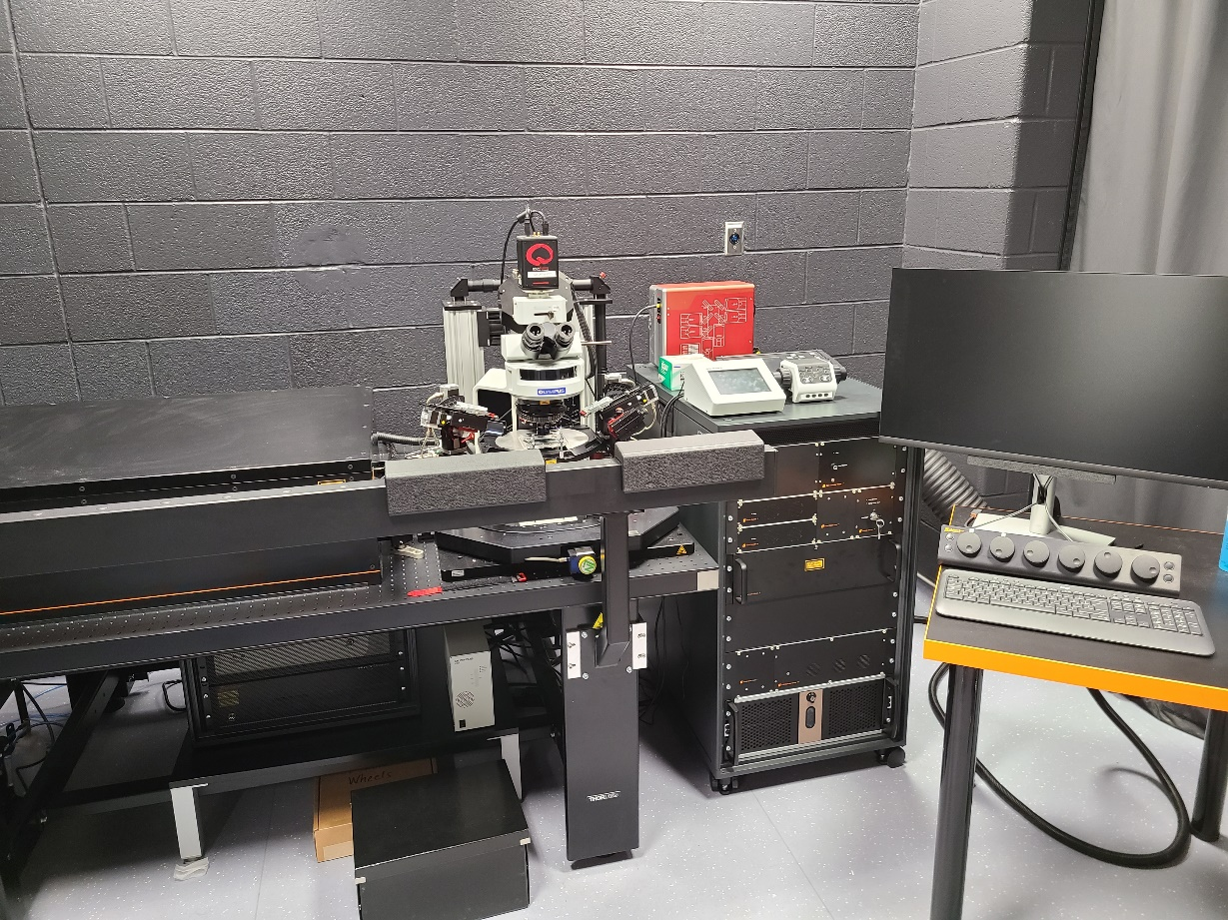
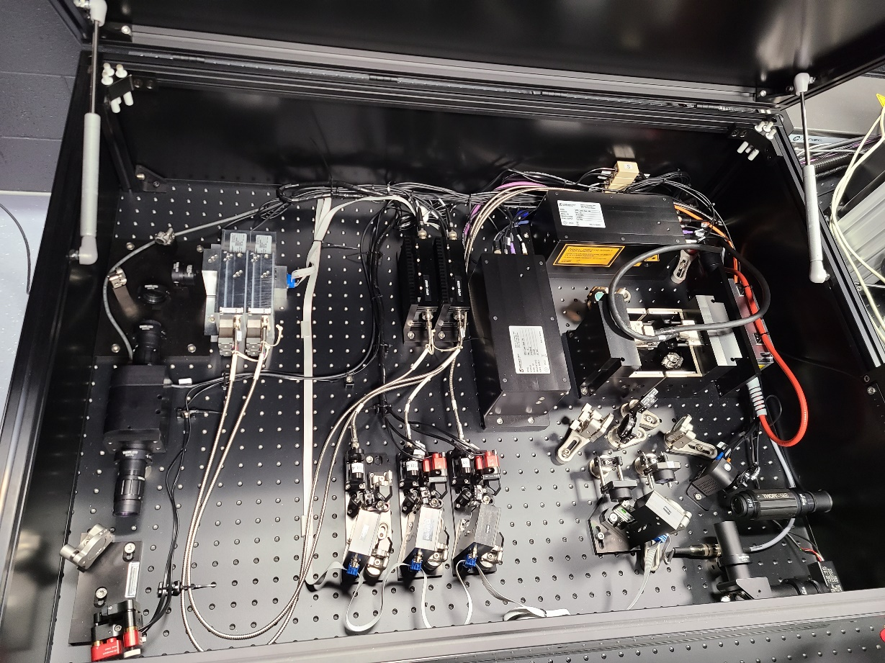
Abberior Expert line STED
+ 920 nm 2 photon laser
595 nm and 775 nm STED lasers
Detectors (APDs)
Pinhole
Excitation Lasers (405, 485, 561 and 640 nm)
SLM (to make the doughnut)

Slide 20










STED nanoscopy of synaptic ultrastructure
Confocal
STED nanoscopy
EGFP
EGFP
Eric Salter
Homer1
Homer1
Graham Collingridge
VGLUT2
VGLUT2
Optimized staining protocol
Non-hardening mounting media
STED
Deconvolution
Merge
Merge

Slide 21
STED nanoscopy of synaptic ultrastructure
STED nanoscopy
EGFP
Homer1
Multiple synapse domains in single spine
VGLUT2
Merge
Eric Salter

Slide 22


In vitro
Applications of STED
Pfeiffer et al., 2019

Slide 23

Scheduled imaging and incubation
Multiflo
Agilent Cytation 5 imager
Robotic arm
Biospa

Slide 24





In vitro
Scheduled imaging and incubation
Brightfield, phase contrast and epifluorescence imaging
CFP, GFP, DsRed, DAPI, YFP, CY5, CY7 and CFP-YFP FRET
Inverted imager
Gas control and injector module allows Calcium imaging

Slide 25





Location 2: In vivo at The Centre for Phenogenomics
Betty-Jo Edgell: Bettyjo.Edgell@phenogenomics.ca
Igor Vukobradovic igor@lunenfeld.ca

Slide 26

In vivo
Olympus FVMPE-RS with a gantry frame
Resonance and galvo scanner
Will have SIM scanner for simultaneous photoactivation with CW lasers (1P)
4 GaAsP detectors
Inner focus: An endoscopic objective with an electrically tuneable lens (ETL)
ETL allows imaging of 2 areas simultaneously and imaging at an angle
Spectraphysics Insight X3 tuneable laser (680 nm to 1300 nm)

Slide 27


In vivo
Neurotar large mobile homecage
Home cage moves freely on bed of air
Air
Mouse is head fixed but has the illusion that it can move around the maze / arena

Slide 28



Tracking capability
In vivo
The device monitors the mouse’s position and trajectory of movement (using magnets) and enables automatic stimuli triggering during closed-loop experiments

Slide 29


Mightex Oasis for imaging and optogenetic stimulation in freely behaving mice
2 m length
0.7 g (3 times lighter than a miniscope)

Slide 30



Mightex Oasis for imaging and optogenetic stimulation in freely behaving mice
0.7 g (3 times lighter than a miniscope)
Dr. Jayant Rai & Dr. Kenichi Okamoto

Slide 31


Junhui Wang
junhui@lunenfeld.ca
Translatable cognitive testing in mice: Bussey-Saksida touchscreens

Slide 32


Slide 33

PAIRED ASSOC LEARNING

Slide 34


Slide 35




In vivo electrophysiology: awake
In vivo electrophys plus touchscreens
Optogenetics plus touchscreens

Slide 36


In vivo electrophysiology: anesthetized
In vivo electrophysiology can be used to measure the electrical properties of neurons in the intact animal.
The setups include Neurostar robot stereotaxic frames AM systems amplifiers and WinLTP software.
Recordings are typically made from the hippocampus or the prefrontal cortex and can be used to study synaptic plasticity such as long term potentiation (LTP) and long term depression (LTD).
This equipment will also be used to study brain oscillations and spiking due to individual cells firing action potentials.

Slide 37
Dual extended wavelength laser multiphoton imaging
In vitro MSB
In vivo TCP
Deep in vivo multiphoton imaging
Super resolution microscopy
Translatable cognitive testing in mice
Simultaneous
in vitro electrophysiology
Automated imaging for development of optogentic probes
Photoactivation and imaging in live behaving mice
In vivo electrophysiology

Slide 38

Special thanks
Early Users
Zhong-Ping Feng
Andie Ovcjak
Zhengwei Luo
Sridevi Venkatesan
Sarah Oh
MeiFeng Yu
Anthony Ariza
Dianshi Wang
Arsene Pinguelo
Eric Salter
Maria Gurma
Rachael Ingram
Jayant Rai
Purchasing
Victor Lee (UoT)
Kevin Hamilton (UoT)
Gareth Taylor (MSH)
Kathie Whiteley (MSH)
Renovations
Jelena Porovic (UoT)
Mark Toone (MSH)
Physiology
Scott Heximer
Paula Smellie
Kathy Ostaff
Jenny Katsoulakos
Graham Collingridge
John Georgiou
Zheng Ping Jia
Lisa Bradley
Evelyn Lambe
Kenichi Okamoto
Beverley Orser
Michael Salter
Lu-Yang Wang
Min Zhuo
Jim Woodgett
Peter St. George-Hyslop

Slide 39




Which wavelength do we use for STED?
Filter
Ex: 485 nm
561 nm
640 nm
wavelength
STED: 595 nm
775 nm

Slide 40
Timeline
Sept 2021
Biotek imager / incubator
July 2020
Renovations begin
March 2021
Renovations completed
MSB
February 2019
1st Meeting/walk around about MSB renovations
March 2023
Scientifica MP
April 2020
RFP issued for MSB renovations
August 2021
Bruker MP
Nov 2021
STED
April 2022
2019
2020
2021
2022
2023
March 2020
Jan 2022 TCP renovations begin
July 2022 TCP renovations completed
September 2018
Tom Sanderson Recruited
COVID
November 2018
1st Meeting/walk around about TCP renovations
Jan 2020 Touchscreens installed
October 2020
RFP issued for TCP renovations
April 2021 preferred contractor drops out
Dec 2022
Olympus MP
Aug 2023
Ephys
TCP
Jan 2023
Photoactivation
December 2020
Preferred contractor selected

Slide 41





Slide 42


Multiple 2 photon imaging / stimulation combinations possible
Spectraphysics Insight X3 fixed output laser (1045 nm)
Spectraphysics Insight X3 tuneable laser (680 nm to 1300 nm)
Spectrahysics MaiTai eHP DS (690 nm to 1040 nm)
3.5W
+
ChRmine
(Marshel et al 2019)
eArch3.0-EYFP
(Prakash et al., 2012)
λ 1045 nm
λ 920 nm

